Slide 1
Aluminum Sulfur Batteries with Select Electrolyte Solutions
By: Liam A. Counasse

Slide 2
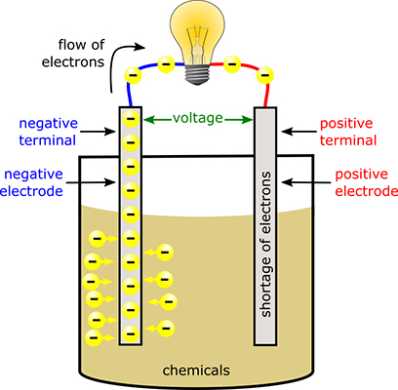
Batteries
Store electrical energy as chemical energy
Convert said chemical energy to electrical energy
Three components: Cathode (+) Anode (-) Electrolyte solution
[10]

Slide 3
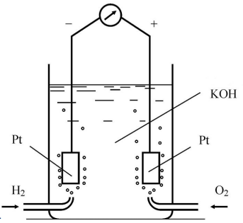
Electrochemistry and Redox Reactions
Electrochemistry: The study of the conversion of chemical energy to electrical energy and the physics involved
Redox Reactions: Chemical and electrical process which explains the functionality of batteries
[12]

Slide 4
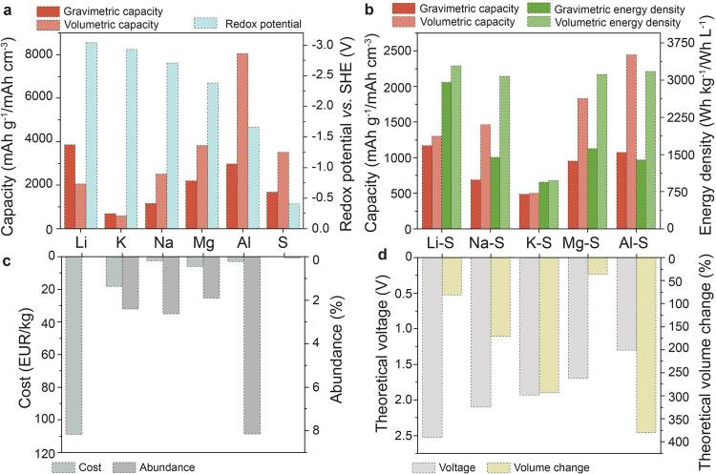
Aluminum Sulfur Batteries
Aluminum - oxidation anode
Sulfur - reduction cathode
1 – ethyl – 3 methylimidazolium chloride (EMIMCl) - electrolyte solution [4]
Water in salt – electrolyte solution [3]
Figure 1: Comparison of batteries and component specifications
Source: Adapted from [2]

Slide 5
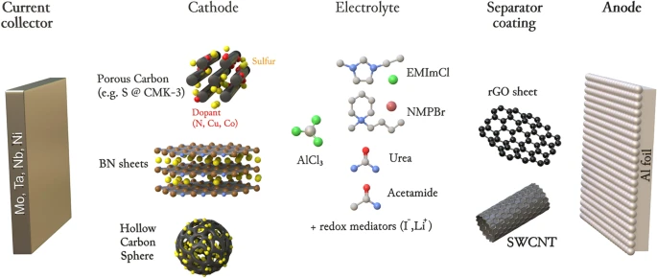
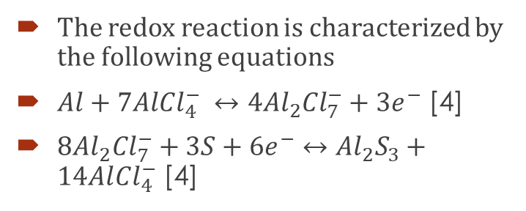
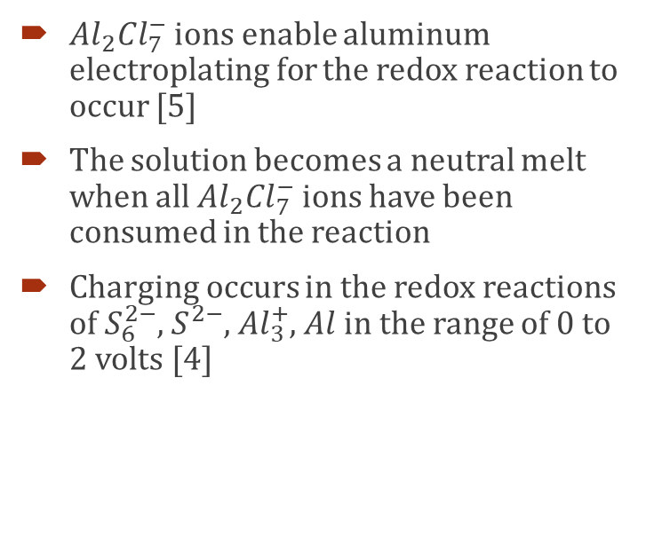
Al – S Batteries with EMIMCl Electrolyte Solution
The redox reaction is characterized by the following equations
$Al+7Al{Cl}_{4}^{−} ↔4{Al}_{2}{Cl}_{7}^{−}+{3e}^{−}$ [4]
$8{Al}_{2}{Cl}_{7}^{−}+3S+{6e}^{−}↔{Al}_{2}S_{3}+14Al{Cl}_{4}^{−}$ [4]
${Al}_{2}{Cl}_{7}^{−}$ ions enable aluminum electroplating for the redox reaction to occur [5]
The solution becomes a neutral melt when all ${Al}_{2}{Cl}_{7}^{−}$ ions have been consumed in the reaction
Charging occurs in the redox reactions of $S_{6}^{2−}$, $S^{2−}$, ${Al}_{3}^{+}$, $Al$ in the range of 0 to 2 volts [4]
[4]
Notes:
Al₂Cl₇⁻ ions allow electroplating of aluminum, occurs only in chloroaluminate melts with an excess of AlCl₃.

Slide 6
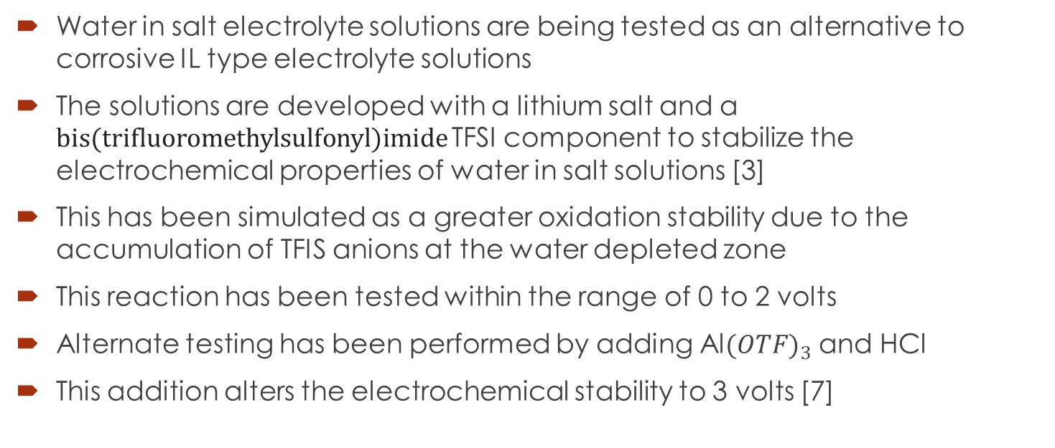
Al – S Batteries with Water in salt Electrolyte Solution
Water in salt electrolyte solutions are being tested as an alternative to corrosive IL type electrolyte solutions
The solutions are developed with a lithium salt and a bis(trifluoromethylsulfonyl)imide TFSI component to stabilize the electrochemical properties of water in salt solutions [3]
This has been simulated as a greater oxidation stability due to the accumulation of TFIS anions at the water depleted zone
This reaction has been tested within the range of 0 to 2 volts
Alternate testing has been performed by adding Al${(OTF)}_{3}$ and HCl
This addition alters the electrochemical stability to 3 volts [7]

Slide 7
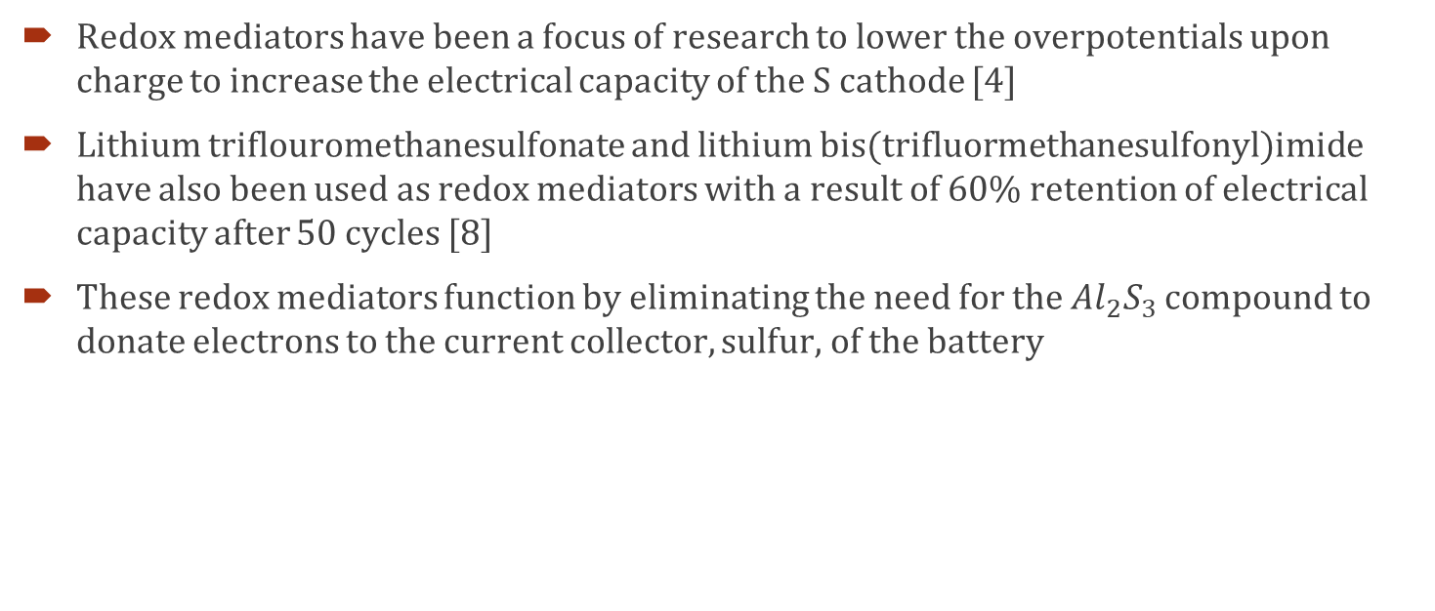
Oxidation Reduction Mediators
Redox mediators have been a focus of research to lower the overpotentials upon charge to increase the electrical capacity of the S cathode [4]
Lithium triflouromethanesulfonate and lithium bis(trifluormethanesulfonyl)imide have also been used as redox mediators with a result of 60% retention of electrical capacity after 50 cycles [8]
These redox mediators function by eliminating the need for the ${Al}_{2}S_{3}$ compound to donate electrons to the current collector, sulfur, of the battery

Slide 8
Challenges to the Advancement of Al – S Batteries
A consistent issue in the development of Al – S batteries is the dissolution of polysulfides into the electrolyte solution
This results in a loss of electrical capacity through degrading the S material of the current collector
Attempts have been made to immobilize these polysulfides by entrapping them within porous conductive carbon materials and copper nanoparticles [8]
More research into the inclusion of redox mediators and polysulfide entrapment must be conducted to achieve a more electrically capacitive Al – S battery

Slide 9
Motivation of the Development of Al – S Batteries
The research into Al – S Batteries is motivated by the abundancies of both materials within the Earth’s crust
Aluminum is the 3rd most abundant material in the Earth’s crust [6]
Sulfur is the 16th most abundant element in the Earth’s crust [6]
Al – S batteries are a proposed alternative to the less safe and more expensive Li – Ion or Li – S battery
Lithium is a rare and difficult element to extract from the Earth’s crust

Slide 10
Dendrite Formations
Dendrite formations are needle-like structures which form on the anode of a battery to the cathode
These formations degrade the battery by potentially creating a short circuit between the cathode and anode of the battery
Al – S batteries have slow or negligible formations of dendrites due to the low specific capacity and redox potential of aluminum
The low or negligible formations of dendrites is a considerable factor in the continued research of Al – S batteries

Slide 11
Applications of Al – S Batteries
Potential large-scale applications: electric vehicles, EV charging stations, power storage systems, etc.
Potential small-scale applications: electric hand tools, cellphones, tablets, computers, small power storage devices, etc.

Slide 12
Conclusion of Analysis and Research
Aluminum sulfur batteries will remain a popular research topic within the field of sustainable power storage
Practical applications and large-scale manufacturing of Al – S batteries will require further research into the following: prevention of polysulfide dissolution through encapsulation or entrapment ideal electrolyte solutions for increasing electrical capacity redox mediators which may prevent the formation of dendrites, dissolution of polysulfides, and increase of electrical capacity

Slide 13
References:
‌[1] D. Chandler, “A new concept for low-cost batteries,” MIT News | Massachusetts Institute of Technology, Aug. 24, 2022. https://news.mit.edu/2022/aluminum-sulfur-battery-0824
[2] H. Li, J. Lampkin, and N. Garcı́a-Aráez, “Facilitating Charge Reactions in Al‐S Batteries with Redox Mediators,” ChemSusChem, vol. 14, no. 15, pp. 3139–3146, Jun. 2021, doi: 10.1002/cssc.202100973.
[3] J. Vatamanu and O. Borodin, “Ramifications of Water-in-Salt interfacial structure at charged electrodes for electrolyte electrochemical stability,” The Journal of Physical Chemistry Letters, vol. 8, no. 18, pp. 4362–4367, Aug. 2017, doi: 10.1021/acs.jpclett.7b01879.
‌[4] M. Klimpel, M. V. Kovalenko, and K. V. Kravchyk, “Advances and challenges of aluminum–sulfur batteries,” Communications Chemistry, vol. 5, no. 1, pp. 1–7, Jul. 2022, doi: https://doi.org/10.1038/s42004-022-00693-5.
[5] P. Bhauriyal and B. Pathak, “Superior anchoring effect of a Cu-benzenehexathial MOF as an aluminium–sulfur battery cathode host,” Materials Advances, vol. 1, no. 9, pp. 3572–3581, Jan. 2020, doi: 10.1039/d0ma00546k.
[6]T. Helmenstine, “Abundance of Elements in Earth’s Crust - Periodic Table and List,” Science Notes and Projects, May 23, 2018. https://sciencenotes.org/abundance-of-elements-in-earths-crust-periodic-table-and-list/
‌[7] W. A. Appiah, H. Li, J. Lampkin, and J. M. García-Lastra, “Towards understanding aluminum sulfur batteries with imidazolium-based electrolytes: A phenomenological model,” Journal of Power Sources, vol. 529, p. 231254, May 2022, doi: https://doi.org/10.1016/j.jpowsour.2022.231254.
[8]X. Yu, M. J. Boyer, G. S. Hwang, and Arumugam Manthiram, “Room-Temperature Aluminum-Sulfur Batteries with a Lithium-Ion-Mediated Ionic Liquid Electrolyte,” vol. 4, no. 3, pp. 586–598, Mar. 2018, doi: https://doi.org/10.1016/j.chempr.2017.12.029.
[9] Z. Hu, Y. Guo, H. Jin, H. Ji, and W. Li, “A rechargeable aqueous aluminum–sulfur battery through acid activation in water-in-salt electrolyte,” Chemical Communications, vol. 56, no. 13, pp. 2023–2026, Jan. 2020, doi: 10.1039/c9cc08415k.

Slide 14
Additional References:
[10] C. Shamieh, Electronics for kids. Hoboken, Nj: For Dummies, A Wiley Brand, 2016.
[11] “The Fundamentals of Electrochemistry.” Available: https://www.cambridgescholars.com/resources/pdfs/978-1-5275-0164-5-sample.pdf
[12] M. Bates, “MIT School of Engineering |» How does a battery work?,” Mit Engineering, May 01, 2012. https://engineering.mit.edu/engage/ask-an-engineer/how-does-a-battery-work/

